Slide 1
FHA Business - Current Considerations
MIDWEST LENDERS CONFERENCE
June 18th 2013
Future FHA Business Prospects
ED TELLINGS
RED Mortgage Capital
MBA Update
Eileen Gray
Mortgage Bankers Association
Capital Markets Update
Karen Cady
Credit Suisse

Slide 2
Future FHA Business Prospects

Slide 3
From The Girl Next Door to Belle of the Ball: the emergence of FHA / HUD as a force in Multifamily Finance
FHA Fills the Credit Void
Why HUD/FHA Multifamily Loan Programs are Likely to Thrive in the Future
5 Reasons for Optimism
Some Challenges to Consider

Slide 4
FHA Fills the Credit Void During FINANCIAL Crisis
Source: HUD.gov HUB initial endorsement data base.
Excludes OAHP 223a7s and OHP health care loans

Slide 5
Multifamily Credit Market Share 2007 - 2012
ORIGINATION VOLUME IN
BILLIONS / MARKET SHARE AS %
Sources: HUD, MBA , FRB and RED CAPITAL Research.

Slide 6
Will it last, or even grow five reasons for optimism
Programmatic Advantages
Competitor Challenges
Rental Housing Demand
Need for Affordable Housing
Recent FHA Converts

Slide 7
Reasons for Optimism #1: Programmatic Advantages
Long-term, Fixed-rate Assumable Financing
Competitive LTV and DSCR Levels
Fixed-rate, Non-recourse Construction Credit
Competitive, Fixed Interest Rates
Residential Healthcare Financing

Slide 8
Programmatic Advantages: Term
FHA Loans offer long, fully-amortizing terms. Competing lenders, with limited exceptions, offer only balloon structures. In a low interest rate environment, borrowers seek to lock-in attractive rates.
Lender | Term (months)
FHA 223f Refi / Purchase | 420
Fannie / Freddie Fixed-rate Balloon | 60 – 120 (360)
Bank & Thrift | 60 – 180
Life Company | 60 – 240
CMBS | 60 – 120

Slide 9
Programmatic Advantages: DSCR
Low Debt-service Coverage Ratio: FHA loans generally bear a Debt-service to NOI Coverage Ratio of 1.20%. Competing products apply 1.25X ratios on even the highest quality loans, and higher ratios on lesser credits.
Lender | MIN DSCR
FHA 223f Refi / Purchase | 1.20X
Fannie / Freddie Fixed-rate Balloon | 1.25X +
Bank & Thrift | 1.25X +
Life Company | 1.30X +
CMBS | 1.25X +

Slide 10
Programmatic Advantages: LTV
Loan-to-Value Ratio Advantages: FHA loans may be funded up to 80% of value, and in some cases slightly more. Competing lenders are generally less aggressive except with respect to the highest quality credits generating exceptional cash flows.
Lender | MAX LTV
FHA 223f Refi / Purchase | 80% / 83%
Fannie / Freddie Fixed-rate Balloon | 65% - 80%
Bank & Thrift | 55% - 75%
Life Company | 55% - 70%
CMBS | 55% - 75%

Slide 11
Programmatic Advantages: Construction Financing
HUD offer the most attractive construction financing in the market: fixed-rate, non-recourse financing with structured permanent mortgage take-out. Construction financing available in the private market consists of Libor-based floaters with full or partial recourse to the sponsor characterized by greater lease-up, revenue and permanent take-out risks.
Lender | MAX LTV
FHA 221(d)(4) New Construction / Perm | 80% - 83% of cost
Fannie / Freddie | Not Available
Bank & Thrift | 65% - 70% of cost
Life Company | Not Available
CMBS | Not Available

Slide 12
Programmatic Advantage: Pricing
Basis point pricing advantage of standard FHA 223f to private lender options
Lender | Spread to FHA 223f Norms
GSE (Tier Plus)
LTV <65% | + 140 bps
LTV>65% | + 120 bps
Bank & Thrift | + 150 bps and up
Life Company | + 130 bps and up
CMBS
LTV <65% | + 135 bps and up
LTV>65% | + 150 bps and up
Generic Ten-year Mortgage Pricing Spreads, June 2013. FHA 223f all-in at approximately 2.95% - 3.20% or 10-year UST + 65 – 100 bps.

Slide 13
Programmatic Advantage: Construction Loan Pricing AND CONVERSION TO PERMANENT FINANCING UPON COMPLETION AND COST CERTIFICATION
 | FHA 221(d)(4) Spreads to Bank Floating Rates Applicable to Construction Loans
FHA Construction – Perm | -20 bps | -70 bps
Generic Pricing Spreads, June 2013. FHA 221(d)(4) 480 month construction to perm all-in at approximately 3.5%. Bank standard 24-month construction loan at Libor + 300 – 350 bps, swappable to 2-year Treasury + 340 bps – 390 bps or approximately 3.70% - 4.20%.

Slide 14
Reasons for Optimism #2: Competitors’ Challenges
Government Sponsored Agencies
CMBS Conduits
Commercial Banks & Thrifts
Life Insurance Companies

Slide 15
Market Outlook: Fannie Mae / Freddie Mac
During conservatorship period (3 – 7 years)
Conservator seeks to limit taxpayer risk and prepare GSE to operate without government credit subsidy
MFH underwriting standards will tighten further
Mortgage insurance premiums will continue to rise, diluting GSE pricing advantage relative to CMBS/Banks
Reform
Uncertain outcome dictated by Congress
GSE MFH Lines of Business may emerge as fully-private or evolve into fully-public entities
Implementation to last a decade or longer
FY2013 restricted goals

Slide 16
Market Outlook: CMBS Conduits
Conduits will continue to struggle to generate sufficient deal volume to support high fixed operating costs and overhead
Conduits will recover market share only gradually as investor confidence in loan underwriting improves and bond spreads tighten
Unlikely to be broadly competitive for class-A/B multifamily product for the foreseeable future
Dodd-Frank risk retention requirements problematic, making securitization highly capital intensive and will make achieving ROEs thresholds challenging.

Slide 17
Market Outlook: Banks & Thrifts
Local and regional banks becoming more competitive for multifamily construction and permanent debt business
Construction loans among their most profitable LOBs
Underwriting terms strict, Libor spreads wide
Personal guarantee and recourse provisions still typical
Aggressively pursing LIHTC business for CRA purposes
Money center and super-regional banks will be hampered by Increased capital requirements pursuant to Basel III, less likely to pursue large construction loan opportunities
Local and regional banks will be less affected by Basel III and are likely to increase as a competitive threat for smaller credits

Slide 18
Market Outlook: Life Companies
Actively seeking CRE lending opportunities, especially in class-A multifamily sector
Highly competitive for the right deals, but remain selective. Prefer urban infill mid-rise and high-rise properties in the major coastal markets. Unlikely to compete actively in Heartland for garden apartments
Appetite for MFH debt stabilizing as absolute rate levels bounce from early-year lows, although returns remain below Life Co. yield hurdles.
Likely to become a larger factor in the market when rates return to levels typical of economic expansions.

Slide 19
Reasons for Optimism #3: Demand for Rental Housing
Demographic Growth
Decreasing Homeownership Rates
Construction Volumes Remain Inadequate

Slide 20
Need for Construction Financing Acute
Demand for rental housing is growing as the rate of homeownership falls. If Americans continue to form new households at a 1.1% annual rate over the next 10 years and the rate of homeownership falls 0.25% per year, the U.S. will need to add nearly 700,000 rental units annually to meet demand, fueling prospective construction loan demand.
Increase of 7 million households over 10 years

Slide 21
Decrease in homeownership
The rate of homeownership in America has declined steadily since 2006, particularly among households headed by persons under the age of 35, the group that traditionally exhibits the highest propensity to rent. Until conventional mortgage financing with relatively low LTVs becomes readily available again, these trends are likely to continue.
Source: U.S. Census Bureau

Slide 22
Forecast change in renter Cohort (ages 16 – 29 years) homeownership rate

Slide 23
5+ Starts Remain Below Trend
While American Households will demand as many 400,000 new multifamily rental units per year over the next decade, construction starts have only recently approached the levels observed prior to the Great Recession
*About one of every three renter households lives in a multifamily dwelling of 20 or more units, producing annual natural net demand for about 240,000 units. In addition, hazard and functional obsolescence removes roughly 0.2% of units in structures of 20 or more units from total stock, producing a net need of roughly 160,000 units annual37, for a total of 400,000 units.

Slide 24
Reasons for Optimism #4: Affordable Housing
Need for Affordable Housing Growing

Slide 25
Core Mission Business is as Vital as Ever: Affordable Housing
Source: RMC Portfolio as a Proxy

Slide 26
NEED FOR AFFORDABLE HOUSING CONTINUED TO GROW
Source: Joint Center for Housing Studies, Harvard University

Slide 27
Reasons for Optimism #5: recent fha converts
Dozens of New Adopters Introduced to FHA
Positive Experience / Repeat Business

Slide 28
New Adopters Likely to Remain Active Customers
Many experienced developers utilized Sect. 221(d)(4) construction financing for the first time
RED’s clients were universally satisfied
All will consider future 221(d)(4) financings
Some have reconfigured business models to conform to the timing and underwriting requirements of the HUD program
Quality market-rate developers have become believers and will not discontinue use of the program when conventional construction lenders return to the market

Slide 29
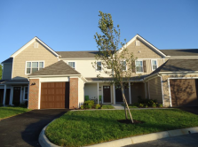
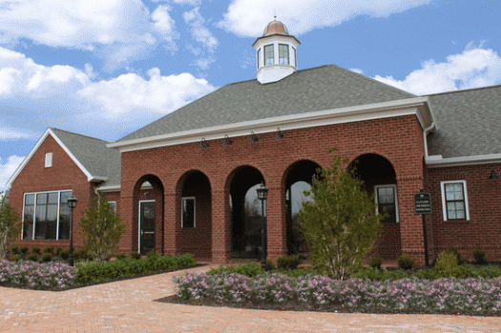
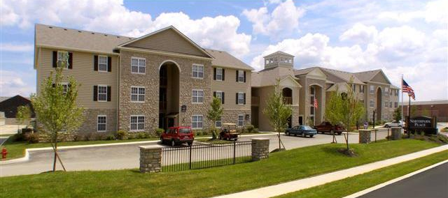
Properties Developed by New Adopters
Properties in the Columbus HUB region developed by new adopters using FHA construction-to-perm credit products
Hilliard Grand, Dublin, OH
Arlington Park, Hilliard, OH
Hilliard Grand, Dublin, OH
Prescott Place, Columbus, OH
Prescott Place, Columbus, OH
Arlington Park, Hilliard, OH

Slide 30
Some Challenges to Consider
Overall HUD Morale
Programmatic Changes/Enforcement
Cost of Funds

Slide 31
OVERALL HUD MORALE
Sequestration
Furloughs
Reorganization
Revised Business Model
Lack of Resources
Notes:
Over the past several years RED has guided several of our most experienced and substantial market rate developer clients through the d4 process. Initially, each was a skeptic, but to an individual all were pleased by the experience, appreciated the benefits of HUD financing and will consider returning to the HUD window for future credit needs. Indeed, some have revised their business models to expressly incorporate the timing and requirements of the d4 program.
These clients are now confirmed fans of the d4 product and the MAP accelerated underwriting process. Not only will they return for additional business but their success will encourage other developers, both portfolio owner/managers and merchant builders, to consider this financing alternative.

Slide 32
Programmatic changes/enforcement
LTV, DSCR, Sponsor Requirements
Secondary Debt Limits
Loss of Section 202 Refinancing Flexibilities
Strengthened IOI Requirements
Availability of Commitment Authority
Davis-Bacon Wage Determination

