Slide 1
Cutting Edge Financing
Options for Affordable Housing:
FHA/GNMA
September 2017
Kent Neumann, Esq. TIBER HUDSON LLC kent@tiberhudson.com 202-973-0107 (direct) 703-568-0190 (cell)
Notes:
1

Slide 2
COMBINED TAXABLE GNMA SALE WITH SHORT TERM TAX EXEMPT BONDS AND 4% LIHTC –
FAQ/ISSUES
Bond Amount to meet 50% test > Taxable FHA Loan Amount:
Other (bankruptcy remote) sources of funds (i.e. bridge equity, subordinate loan proceeds, etc.) are needed to cover the differential. Timing of funding is critical. Seller Take-Back loan can often be used to collateralize bonds (see applicable slides)
Investment and other options to reduce cost:
Although short term rates have gone up, taxable investment options have gone up also: Ex.1.25% bond rate less 1.25% investment rate = 0.00% net interest cost per year on bonds.
Seller Take-Back Bonds can sometimes be used to help reduce costs further (see applicable slides)
Multiple loans/projects can be pooled into a single bond issuance to spread out fixed closing costs – all deals need to be in a position to close within the same timeframe.

Slide 3
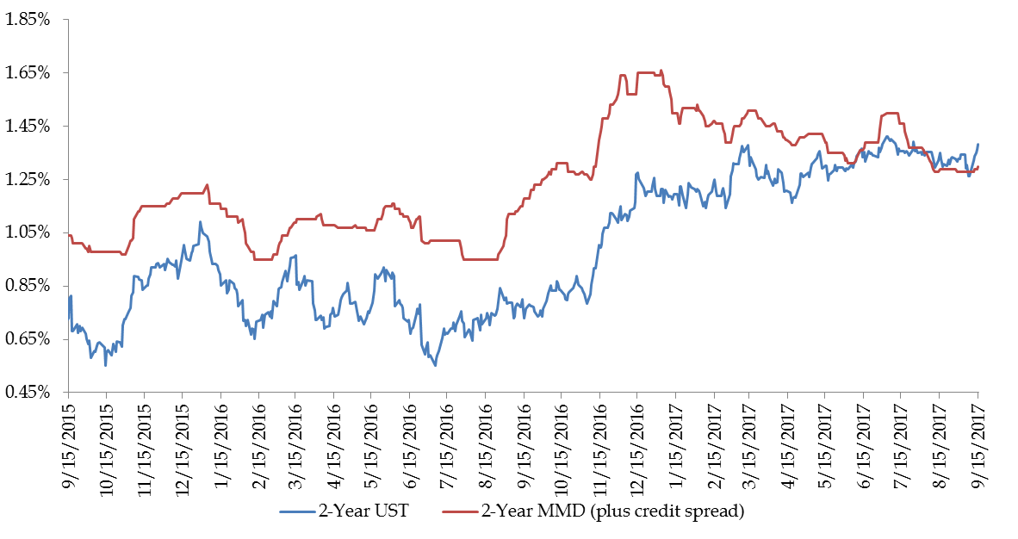
Despite the recent increase in short-term, tax-exempt rates, the negative arbitrage deposit can still be significantly reduced.
Historical Performance for 2-Year MMD (plus credit spread) and 2-Year UST
Source: Bloomberg. Thomson Reuters
Reflects market conditions as of September 26, 2017
Thomson Reuters Municipal Market Data (MMD) AAA curve is a proprietary yield curve that provides the offer-side of AAA rated state general obligation bonds

Slide 4
COMBINED TAXABLE GNMA SALE WITH SHORT TERM TAX EXEMPT BONDS AND 4% LIHTC –
FAQ/ISSUES
Publically Offered vs. Privately Placed:
Potential tax implications if Bond Purchaser is “related” to the Borrower (see §1.148 program investment regulations)
Costs of issuance are very close. Interest and investment options can vary.
Issuer considerations:
Possible limitation on Issuer Fees due to short maturity and Loan Yield limitations
Some states have very limited private activity volume cap – although this structure does use the minimum amount of bonds to meet the 50% test
A few Issuers do not allow the structure due to limitations on fees.

Slide 5
Tax-Exempt Seller “take back” Note & Bonds
Many 4% preservation deals and affordable transaction located in high cost areas require subordinate gap and/or “soft” funds to get the financing to work. This can often include seller financing in the form of a subordinate “take-back” note for deals with a “friendly” seller. This is very common in RAD transactions.
These deals will have higher eligible basis for tax credits (generating more tax credit proceeds) but no significant impact the size of the permanent loan.
Due to the LIHTC 50% test, tax-exempt bonds in excess of the permanent financing are often required in these deals.

Slide 6
Tax-Exempt Seller “take back” Note & Bonds (con’t)
Option 1: Instead of allocating the seller note to a reduction of the purchase price of the Project, Bond proceeds can often be “allocated” for the full purchase price of the Project and the seller can “allocate” the note as new funds to the deal – which can be used to collateralize that portion of bonds.
Makes it much easier to meet the 50% test (equity or other soft funds are no longer needed for collateral.
Often results in saving from additional investment opportunities and eliminating the need for bridging of other collateral funds.

Slide 7
Tax-Exempt Seller “take back” Note & Bonds (con’t)
Option 2: Instead of issuing additional short-term tax-exempt bonds that will be sold to 3rd party, it is often possible to convert some of the subordinate debt to tax-exempt through the project’s “placed-in-service” and then convert it to taxable debt thereafter.
By running the surplus cash note from the Borrower to the municipal bond issuer, creating a corresponding note from the Issuer to the Seller and allocating the corresponding amount of tax exempt bond volume cap to the acquisition of the project, the note would apply towards meeting the 50% test – even though no cash is actually moving.
Results in significant interest saving from the reduction of debt service on the “take back” Bonds.
Note that tax-exempt private activity volume cap and any upfront/ongoing issuer fees would still be applicable.

Slide 8
FHA Refinancing to Resyndication (R2R) Program for Affordable Projects
GOAL: Lock in todays low financing rates for future tax credit deals.
Applicable for existing affordable housing projects still in 15-year tax credit compliance period (target: years 9-14) or otherwise not yet ready for tax credit syndication.

Slide 9
NEW FHA Refinancing to Resyndication (R2R) Program for Affordable Projects
NEW LOAN: Current owner (or new purchaser) can use a taxable fha loan (223f or 223(a)(7)) to refinance existing debt or purchase an affordable project.
Goal is to keep rehab to a minimum (preserve as much as possible for future tax credit deal).
Highlights of 223f loan:
Exempt from LIHTC 10-year rule (Section 42(d)(6))
35+ year full amortization and term
80-90% LTV / 1.11 DSCR
~3.50% all in mortgage rate including 25bps MIP for affordable deals
Possible exemption from Davis Bacon wages; Non-recourse

Slide 10
FHA Refinancing to Resyndication (R2R)
WHEN READY TO INTEGRATE TAX CREDITS (Upon Year 15 or otherwise): Owner would simultaneously take 3 steps…
Step 1: Sell project to new tax credit borrower at full appraised value - with ~3.50% fha debt in place (not prepaid) pursuant to HUD’s TPA (transfer of physical asset) process.
TPA can take 90-120 days
Remaining term of fha loan would be 30+ years
No prepayment fees or substantial transfer fees are applicable for TPA

Slide 11
FHA Refinancing to Resyndication (R2R)
Step 2: Close on a new supplemental FHA 241(a) loan equal to the lower of (a) 90% of rehabilitation and related construction costs or (b) 1.11 dscr for total fha debt.
241(a) loan highlights:
Designed as a supplemental loan in second position behind a senior fha loan.
Is a construction loan program (clc/plc) and not limited to 223(f) pilot rehab limits.
Loan term/amortization can be up to 40 years although default is for it to match the remaining term on the senior fha loan.
Possible exemption of Davis Bacon wage requirements (depends on senior fha loan in place).

Slide 12
FHA Refinancing to Resyndication (R2R)
Step 3. Use tax exempt bonds in an amount necessary to meet the 50% test to qualify for 4% tax credits (generating ~35% of additional sources of funds).
Need to issue bonds in excess of 50% of aggregate basis to qualify for 4% low income housing tax credits
95% Bonds need to be spent on “good” costs of project – excluding existing assumed fha debt in senior position
If not enough “good” costs to spend all bonds, a portion of the existing fha loan may need to be repaid just enough to free up additional “good” costs. Original 223(f) loan can be structured to allow for this flexibility. Could also allow for increased 241(a) sizing depending on constraint.

Slide 13
Refinancing to Resyndication (R2R) with FHA
Results:
Locks in today’s low rates for ~70% or more of the total debt
Avoids prepayment fees/costs on fha loan (~5-9% of loan balance)
Compare:
vs.
→ Over $100,000 in annual debt service savings and eliminates ~$500,000 in potential prepayment fees.
Loan | Amount | Rate | Annual Pmt | Tax Credit Year
223(f) | $7,000,000 | 3.25% | $335,100 | 10
241(a) | $3,000,000 | 5.25% | $187,464 | 15
Total: | $10,000,000 | 3.825% | $522,564
Loan | Amount | Rate | Annual Pmt | Tax Credit Year
223(f) | $10,000,000 | 5.25% | $624,888 | 15

Slide 14
Refinancing to Resyndication (R2R) with FHA
Although this is a very streamlined/ state-of-the-art execution, it does have a lot of moving and inter-related parts. Many assumptions are required in order to demine future sizing of the transaction. As such, it is very important to work closely with the borrower as well as Bond and 4% tax credit experts to model deals with conservative assumptions. These include:
Purchase price (subject to appraisal)
Scope of rehab and related costs
Tax credit equity pricing
Aggregate basis calculation (for bond sizing)
Mortgage rate/term on 241 loan

Slide 15
Kent Neumann, Esq. TIBER HUDSON LLC kent@tiberhudson.com 202-973-0107 (direct) 703-568-0190 (cell)

