Slide 1
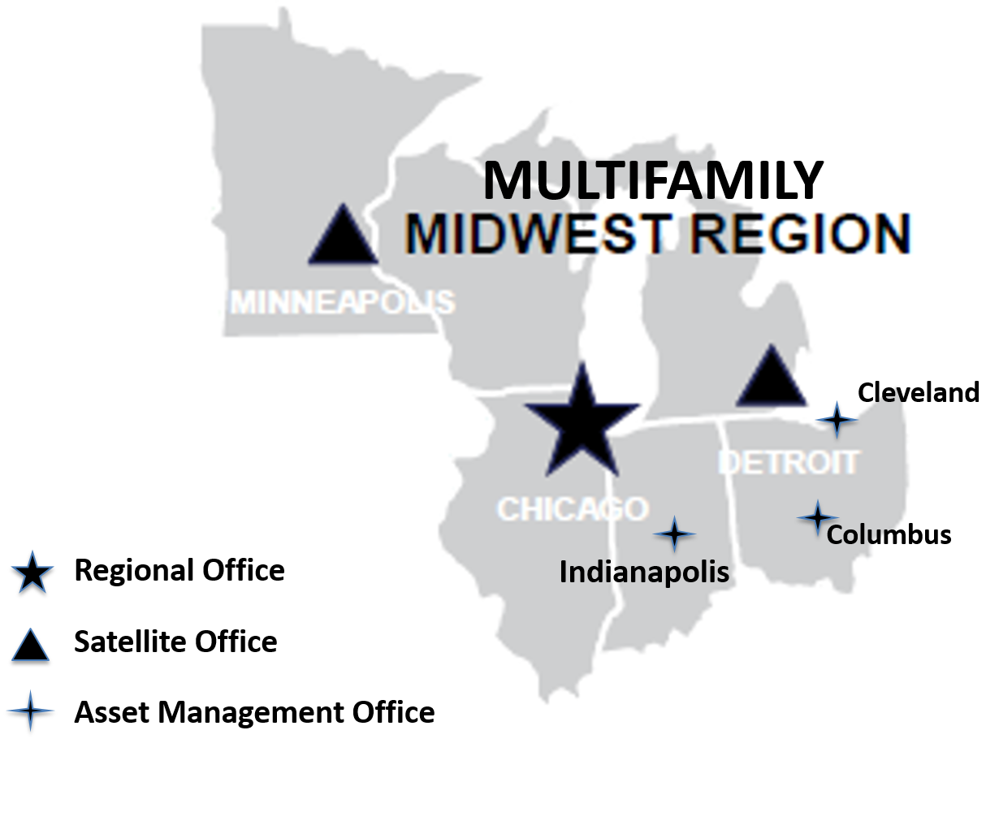
Multifamily Midwest Report for Midwest Lenders Conference Daniel Burke, Director Multifamily Midwest Region September 28, 2017
Milwaukee

Slide 2
Facts about the MF MW Region
6543 assets under management – 2nd largest portfolio in nation after the Northeast’s 7915 assets – in the smallest geographic region—Ohio, Michigan, Indiana, Illinois, Wisconsin, Minnesota
In FY 17 YTD, issued 207 basic FHA Firm Commitments totaling $2.2B; in addition, 13 Risk Share deals totaling approx. $100M
In FY 16 Issued 234 Firm Commitments totaling $2.4 B, 1st in the nation
Processed 20 Workload Sharing Loans for other Regions—most in nation– taking on additional applications to support SW Region Due to Harvey

Slide 3
Facts about MF MW Region Cont.
Collaborative and Experienced Leadership Team that has implemented workload efficiency best practices that are replicated at national level including:
1) AMPS – Asset Management workload management and accountability system developed in the Midwest and deployed nationally during MFT – improved customer service, employee performance and processing action turnaround times.
2) Regional Technology Team—Cross regional team to develop workload efficiency tools using existing technology, most recently a financial statement analysis tool.
3) Workload Sharing – The Chicago office had been workload sharing in production long before national adoption and was instrumental in developing the standard operating procedures for workload sharing within the region and outside of it.

Slide 4
Examples of Cross Regional Collaboration & Midwest Leadership
Chicago is a RAD processing center - Regional RAD Processing Teams in Production for RAD projects insured with FHA Loans and RAD Specialists in Asset Management for Administration of RAD HAP Contracts
Collaboration with Southeast Region to establish dedicated team to service a large portfolio of a common owner in both Regions to achieve consistency in servicing

Slide 5
Distinctive Market Factors in Multifamily Midwest Region
FHA Insurance leading tool for financing market rate construction in markets such as Detroit, Cleveland and Milwaukee which are rebounding but have had difficulty attracting conventional capital
Increase in Transit Oriented Market Rate New Construction
Strong RAD and LIHTC Program Knowledge and Execution
Largest number of Troubled Assets under Management due to economic impacts in Rust Belt states (overall portfolio size 6543) :
Status | Troubled
# of projects | 412
% of MW portfolio | 6.3%

Slide 6
Distinctive Market Factors in the Region Cont.
High Volume of 223 (f) Loans in State of Indiana (25% of the 223 (f) loan volume in our 6 state region)
Revitalizing key neighborhoods in Chicago, Cincinnati and Columbus with Choice Neighborhoods Initiative

Slide 7
Success of New Business Model under Multifamily Transformation (MFT)
Asset Resolution Teams have successfully worked out highly complex troubled asset portfolio issues
Single Underwriter Model has led to dramatic increase in speed and quality of underwriting loan applications and ability to assign work where there is capacity
Regional Operations Team supports key functions for Region—travel, training, contracting, Information Technology, Stakeholder Communications

Slide 8
Regional Challenges
Solutions for legacy 202/811 properties dependent on human services funding
Coordinating necessary Asset Management Reviews with the Production processing when financing a currently assisted project
Assuring timely construction inspections – Now accessing National Construction Inspection third party contract for fee inspectors

Slide 9
Staffing

Slide 10
Midwest Regional Leadership
Multifamily Midwest Regional Center Director
Dan Burke
Chicago
Chicago Asset Management Division Director
Debbie Gray
Chicago
Detroit Asset Management Division Director/ Satellite Office Coordinator
Susie Sapilewski
Detroit
Minneapolis Asset Management Division Director/ Satellite Office Coordinator
Laura Simpson
Minneapolis
Production Division
Production Division Director
Mary Anderson
Chicago
Operations Division
Operations Officer
Ryan LaFollette
Chicago

Slide 11
Multifamily Midwest Region Staffing
Divisions | Current Staff Level
Chicago Production | 25
Minneapolis Production | 13
Detroit Production | 16
Production Total | 54
Chicago AM | 60
Detroit AM | 53
Minneapolis AM | 29
Asset Management Total | 142
Operations Total | 7
Regional Director Office | 2
Total | 205
Notes:
The 20 slots that we are down, does include the 2 recent hiring approvals to be onboarded this FY.

Slide 12
Asset Management

Slide 13
MF Midwest Assisted Portfolio
Regional Total | Properties | Units
 | 6,169 | 548,618
Rent Assisted
State | Properties | Assisted Units | Rental Assistance Funding
IL | 837 | 69,305 | $731,150,247
IN | 484 | 32,308 | $466,054,739
MI | 656 | 59,373 | $486,349,306
MN | 642 | 33,903 | $274,826,054
OH | 1,251 | 81,892 | $780,502,259
WI | 636 | 33,355 | $675,512,962
Total | 4,506 | 310,136 | $3,414,395,567

Slide 14
MF Midwest Insured Portfolio
State | Properties | Units | Unpaid Principal Balance
IL | 463 | 58,728 | $3,478,295,115
IN | 561 | 74,162 | $3,087,111,516
MI | 506 | 74,162 | $3,168,506,917
MN | 461 | 44,409 | $2,832,414,154
OH | 666 | 73,882 | $2,835,985,452
WI | 217 | 21,592 | $1,217,587,577
Total | 2,874 | 347,035 | $16,619,900,734

Slide 15
Production Data

Slide 16
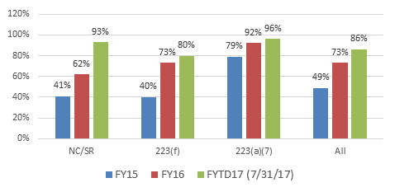
MFT: Production FHA-insurance Application Processing Times – Proven Success of MFT over 2-year Period
% of Firm Commitments issued in DAS time frame since
MFT Transformation – Midwest Region

Slide 17
Midwest Closings (10/1/2016 – 07/31/2017): 197
Closings By State
Closings By Section of the Act
State | Closings
IL | 39
IN | 28
MI | 42
MN | 21
OH | 45
WI | 14

Slide 18
FY 2017 Goal Performance (as of 8/31/2017)
Notes:
Checking with Bob – why are there more 223a7 closings than firm commitments

Slide 19
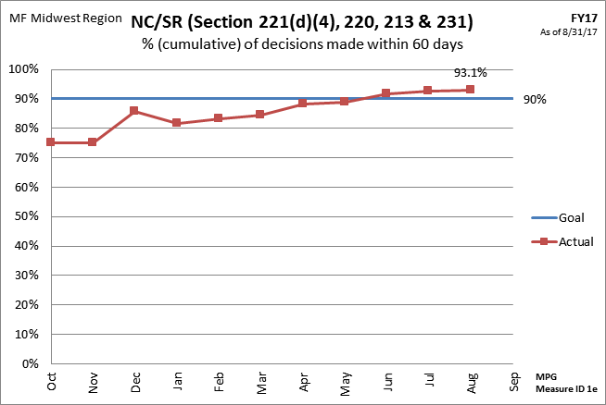
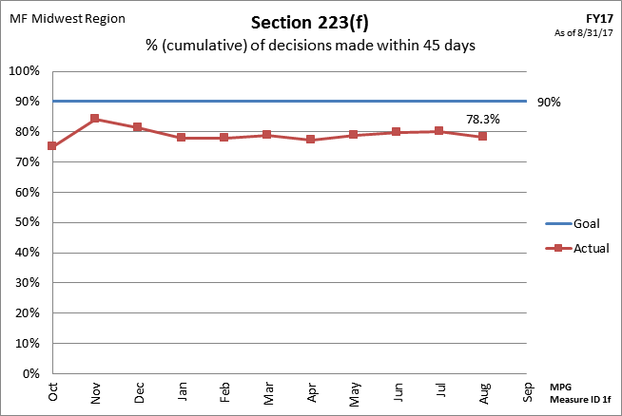
Midwest Goal Performance

Slide 20
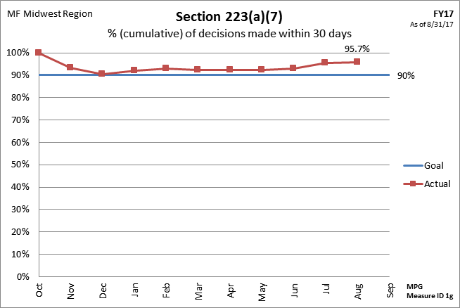
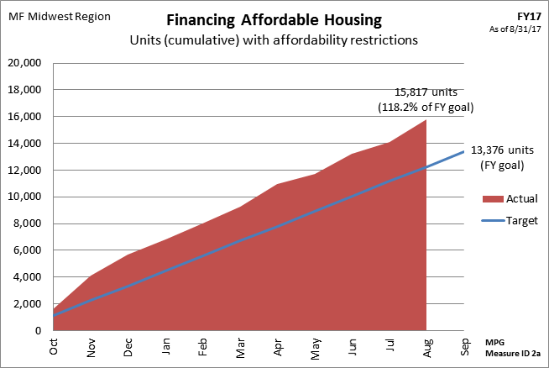
Midwest Goal Performance

Slide 21
Non-Critical Repair Escrow Requests
Email your completed HUD-92464M Request for Approval of Advance of Escrow forms to midwest.ncescrow@hud.gov
Please include you NCR Escrow Agreement in your first draw request email
Staff members monitoring the inbox will track and distribute to appropriate staff members to process your request
Total project repairs that require an architect / general contractor, that are over $15k per unit or that were initially endorsed prior to 3/1/2016 will be serviced by Production staff
All other requests will be serviced by Asset Management staff

Slide 22
Multifamily Midwest Region Website
https://www.hud.gov/states/shared/working/r5/multifamily

Slide 23
Multifamily Midwest Region Website
Asset Management Portfolio Assignments – Account Executive Assignments by State
Production Information – Key Staff and Application Submission Protocol

