Slide 1
Data Integrity
Midwest Lenders Conference
September 6th, 2018
Office of FHA Multifamily Production
U.S. Department of Housing and Urban Development

Slide 2
System Integration and Data Integrity Problem
HUD’s Multifamily Production and Finance & Budget offices have several issues related to integration of their systems and integrity of their data
2017 audit finding of material weaknesses related to timing differences in obligation and disbursement of multifamily guarantees – subsidy costs associated with loan guarantees not being recorded in a timely manner
Manual recording of transactions in several dated systems, and no process in place to ensure that loan information is consistent between various systems
Currently implementing audit recommendations – developing and implementing policies, procedures, and controls to ensure that subsidy expenses are recorded in a timely manner, as well as reconciliation process to ensure that information is consistent between various systems

Slide 3
To paint a picture… Here’s how HUD’s Multifamily Production/ Finance & Budget Systems work (or don’t work) together…

Slide 4
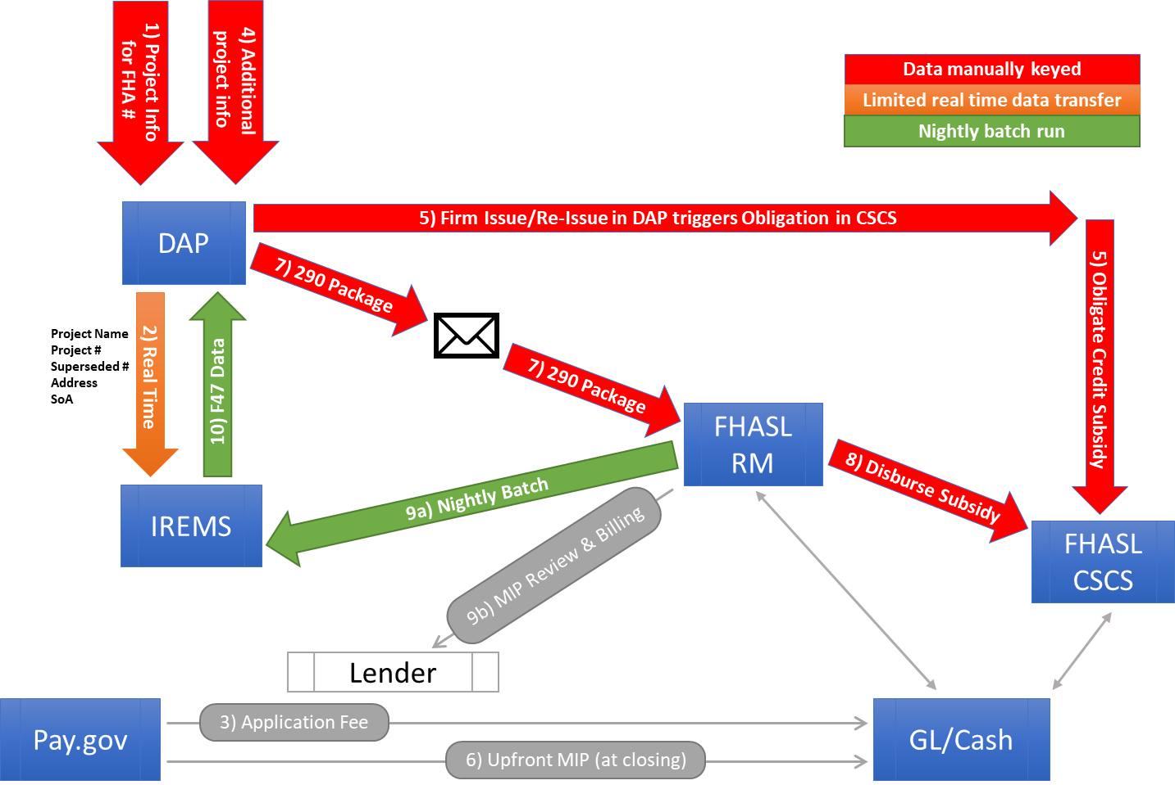

Slide 5
System Integration and Data Integrity Problem
Most of what needs to be done is outside of Lenders’ control, and multiple offices within HUD are actively working to correct these problems, but…
Through this work, we have identified secondary issues – within Lenders’ control – that can contribute to delays in recording of transactions, as well as more inconsistencies/errors in loan and transaction data that create problems in other systems, requiring time-consuming corrections: 1) Errors in FHA Project #s, and 2) Errors in Pay.gov payments

Slide 6
So here’s what you can do to help us…

Slide 7
Requests for FHA Project #s
Request must include all information in MAP Guide Appendix 4G.1 (right) and MIP Category/Rates – if not, it will be returned for add’l info
Project Name is how this project will be forever known in all HUD systems – make sure it’s what you truly want it to be
Get it right the first time!: SOA and geographic project location (these determine the FHA # prefix), timing of insurance, application stage
If the proposed loan will refinance an existing HUD-insured loan, PLEASE provide the current FHA # that will be superseded…this is critical
Make sure you tell us all applicable special characteristics (LIHTC, Tax Exempt Bonds, etc.) – this is important for risk ratings/credit subsidy
We need all addresses for scattered sites
For projects in Midwest Region, submit requests to: chi.fhanumber@hud.gov

Slide 8
Requests for FHA Project #s
If we generate a FHA Project # and later discover an error, it creates many problems in multiple HUD systems, which are very time-consuming to fix – please help us avoid this!

Slide 9
Pay.gov payments
Follow instructions in MAP Guide Appendix 4G.3-4 (right)

Slide 10
Pay.gov payments
Pay application fee and other fees at Pay.gov – HUD Office of Multifamily Production Program Fees (right): https://www.pay.gov/public/ form/start/67950760
Treasury system, not connected to our DAP system – requires manual entry by Lenders, no automatic validation at time of submission
Triple-check!: FHA Project #, Project Name, Program Type (SOA), “Project Type” (multiple options for a7’s), Fee Type
Correctly indicate LIHTC, Tax Exempt Bonds – and by “Tax Credits,” we mean only LIHTC
Make sure “Section of the Act” 3-digit SOA code matches what HUD office provides
We will be reviewing receipt and verifying info at application/closing – if errors, have to correct w/ change request form to General Ledger or require repayment/process refund

Slide 11
Regional Data Integrity Teams, if questions
If you have issues or questions, contact one of the applicable Regional Data Integrity Team Members (right)
Region | Primary | Alternate
Southwest | Lisa Campfield | Leslie Winston
Midwest | Scott Greuel | John Schneider
Southeast | Carol Ward | Danny Gordon
Northeast | Katie Downes-Angus | James Shelton
West | Shannon Bergman | Elaine Chavez
HQ | Scott Greuel | Daniel Clark

