Slide 1
The Outlook for Major Midwest Apartment Markets Daniel J. Hogan, RED Capital Group / ORIX Real Estate Capital
14 May 2019 1:00 PM
Midwest Lenders Association Market Study Seminar

Slide 2
Agenda
National Economic Fundamentals – Our Base Forecast
National Market Rate Fundamentals and Forecast
Major Midwest Markets
Chicago
Detroit
Minneapolis
Midwest Total Return and Risk-adjusted Return Comparisons
CBD/Infill Performance: Columbus, Indianapolis, Milwaukee

Slide 3
Gross Domestic Product: Surprising Momentum
Notes:
Let’s begin by taking a look at US GDP trends. The graph depicts the year on year growth rate of Real GDP and Current Dollar or Nominal GDP. As we have heard a great deal lately, the first quarter Real GDP print was quite extraordinary. Both the Year-on-year and Q/Q SAAR figures were 3.2%. On the YoY basis, this was the strongest print in four years, which is pretty notable in itself. It is also worth noting the catalysts of this growth, which were in large part private fixed investment, inventory investment and improved net exports. For want of a better term, these are supply-side stimulants. The one notable demand-side stimulant was government spending, which looms as the one bright risk to the broader economic picture.
The key takeaway here is that this growth spurt is being fueled by investment and productivity growth rather than consumption. It is very unusual to see this kind of behavior at this late moment in the expansion cycle, and it bodes well for the future.
Why? Supply-side driven expansion is inherently anti-inflationary. Which seques nicely to our NGDP line. As you can see, NGDP growth is slowing even as Real GDP is accelerating. This is the case because inflation is declining even as the economy accelerates and slack, at least theoretically, is being quickly exhausted.
For the most part, this is good news for the multifamily industry. Faster output growth correlates to faster job and income creation and household formation. On the other hand NGDP is more correlated to rent growth than GDP. In otherwords, the pattern we see here may contribute to somewhat slower rent growth, all things bieing equal.

Slide 4
GDP Price Deflator: Decelerating Inflation
Notes:
Here’s another look at the inflation trend. The GDP deflator is at its lowest point since this latest growth spurt began in the summer of 2016.

Slide 5
Payroll Job Growth: Considerable Strength
Notes:
Here’s the YoY payroll job growth curve. Nothing too notable here other than the fact that we’re seeing moderately faster job growth over the past nine months, irrespective of the fact that the pool of available labor is shrinking and inflation is decelerating; a fact pattern that directly contradicts the Natural Anti-inflationary Rate of Unemployment or NAIRU orthodoxy.

Slide 6
Real Personal Income and Expenditure Growth: Constructive, Non-inflationary Trends
Notes:
Here are Real Personal Income and Spending trends. Notably, each is rising slower than Real GDP, which reflects a healthy net positive allocation of national income toward investment rater than spending, in marked contrast to what we see in 2015. Moreover, spending and income growth are rising more or less in tandem, which reflects positively on consumer debt and savings behavior. In other words, we aren’t seeing the large growth in consumer debt that predated the last financial crisis. All good.

Slide 7
Wage Growth: Wages Rising but Increasingly in Line with Productivity Growth
Notes:
Here are wages and productivity. Wage growth is accelerating, and that’s positive for landlords as it contributes to rising rents. At the same time, the increase is not out of line with productivity growth. Hence, the rise in wages has not so far contributed to an acceleration of unit labor costs or inflation.

Slide 8
Key Takeaways: Goldilocks Economy for Now
Economic Growth is Robust and Accelerating Modestly
Rate of Inflation is Below the Fed’s 2% Target and Moderating
Payroll Job Growth is Surprisingly Strong Despite Low Unemployment, Implying Worker Re-entry, notwithstanding Contrary Data
Wages are Rising but due to Productivity Improvements Worker Gains are Not Yet Pushing Unit Labor Costs Higher
Income and Consumption are Rising Moderately and in Tandem
No Evidence to Suggest Recession is Imminent.
Primary Risks are Structural (Fiscal Deficit), Manageable in the Intermediate-Term

Slide 9
Gross Domestic Product Forecast
Notes:
Here are the model GDP forecasts that underpin our metro apartment performance forecasts. Note, that these projections are developed from entirely unbiased, historically specified equations. As such, by definition they tend toward mean reversion, and when they encounter ahistorical relationships among data, they tend to correct the historical anomalies quickly. This is what we see here. The models insist that the level of GDP growth we have experienced is incompatible with the personal income and job growth and inflation we’ve observed recently, and moves to adjust it accordingly.
Logically, this in unlikely to happen. Clearly, the economy is performing differently than it has over the past 20 years, and it appears that we now can enjoy faster output growth and stable inflation simultaneously.
The implications of this for the multifamily industry cannot be underestimated. What it implies is that we can have constructive levels of job growth and household formation rates without grappling with the higher inflation and interest rates that have historically accompanied them. The impact of this phenomenon on expected investment returns from multifamily investments is material and can only be viewed as a big plus for our industry.

Slide 10
GDP Price Deflator Forecast
Notes:
Here’s the inflation forecast, which needs no comment.

Slide 11
Payroll Job Growth: Forecast

Slide 12
Real Personal Income and Expenditure Growth: Forecast

Slide 13
Implications of the Forecast
Our forecast is intended to represent a feasible or “most probable” basis for our multifamily forecasts, not a prediction.
It implies that the most probable outcome for the US is neither recession nor boom; rather a period of moderate, low inflation growth.
The implications for the multifamily industry are significant.
Under these circumstances, we would expect to find consistently low 10-year Treasury rates, stable financing costs and more or less stable capitalization rates.
According to our models this is a very attractive environment for multifamily ownership characterized by constructive NOI growth, attractively low exit cap rates and low NOI volatility.
The immediate impact of inputting the 1Q19 GDP and income data in the model was to raise ETR by 15bps to 7.75%, highest ever. The effect on Midwest, with its high cap rates and NOI stability was greater.

Slide 14
RED 50: Occupancy Forecast
Notes:
Okay, so here is RED Research’s occupancy forecast for the RED 50, the 50 major US markets that we model econometrically. Occupancy is expected to decline this year as we work through the supply bulge that is hitting most markets in 2019 and 2020. We expect overall occupancy to grind higher 2020 as supply pressures recede a bit.

Slide 15
RED 50: Effective Rent Growth Forecast
Notes:
Here’s the effective rent forecast. Rent trends are likely to decelerate as we try to digest the supply wave, but should recover lost momentum a supply levels recede. It’s notable that our historically specified models have consistently under-forecasted rent growth in this cycle and I tend to think we continue to do so here as homeownership remains less of a competitive threat than before and the underlying bid for apartment space appears to be less elastic relative to price than in years past for a host of demographic and tax policy reasons.

Slide 16
Ten-year Yield: Forecast

Slide 17
Baa Bonds & Cap Rates: Forecast
Notes:
Just for fun, here’s the B/B+ cap rate proxy forecast. The model projects that cap rates still have some room to move lower and that the factors that are the principal drivers of cap rates – 10-year UST yields, Baa-rated bond yields and Nominal GDP growth – are likely to be more favorable to multifamily investors than not.

Slide 18
CHICAGO
CHICAGO
CHICAGO
CHICAGO
CHICAGO
CHICAGO
CHICAGO

Slide 19
Chicago Key Economic Indicators & Forecasts
Notes:
Okay, let’s look at our major Midwest markets in light of this macro forecast. Heading in alphabetical order I’ll begin with Chicago.
These graphs compare Chicago MSA’s personal income and payroll growth to the RED 50 averages. As for PI growth, Chicago tends to trail the market average and this is likely to persist, although we foresee some slight narrowing of the degree of Chicago’s underperformance. As far as job growth is concerned, metro performance relative to the index improved considerably over the past year, largely due to better performance in the goods producing industries in general and auto manufacturing in particular. This bodes well for the future an we expect Chicago to exhibit stronger relative performance to the peer group over the 5-year forecast interval.

Slide 20
METRO CHICAGO SUPPLY AND DEMAND
Notes:
Here are recent permitting trends. They moderated materially, which we believe is attributable to reduced interest in mid- and high-rise investments in and around the Loop. This is probably wise should future job growth be better balanced between goods producing and office using industries than it has been in the recent past.

Slide 21
Notes:
Here are the metro supply and absorption projections. Things look quite optimistic for 2019, when we expect that strong job formation will keep space demand robust, giving rise to slightly higher occupancy despite heavy supply. With slower economic growth if not recession in store for 2020 and 2021, our models sense a risk of significantly lower demand and declining occupancy rates -- in this case about 50 basis points -- regardless of fewer completions.

Slide 22
Chicago: Effective Rent Growth Forecast
Payroll growth, the rate of change of occupied stock growth and occupancy change^3 are significant.
Notes:
Here is the corresponding effective rent forecast. A slowdown is in offing – job and demand growth and occupancy change are statistically significant predictors – and theyu all point to deceleration. But overall, Chicagoland rent growth should compare pretty well to the national norm.

Slide 23
Chicago Supply 2019 – 2020: Urban Core v. Other Metro SUPPLY (CITY WEST, LOOP, GOLD COAST)
According to Reis, more than 50% of Chicago supply completed in 2017 and 2018 was delivered to the City West, Gold Coast and Loop submarkets. In the next two years, this figure is expected to decrease to 42%. By 2021-2022, the figure is projected to be less than 15%.
Notes:
Okay, let’s take a peak at the infill submarkets. We define the urban core as the Reis-defined Loop, Gold Coast and City West submarkets. In 2017-2018, these submarkets accounted for 53% of Chicago’s totaled delivered units. This year and next, this figure is expected to fall to 42%, and further to less than 15% in 2021 and 2022. This suggests to us that the performance outlook for the Chicago Urban Core is constructive.

Slide 24
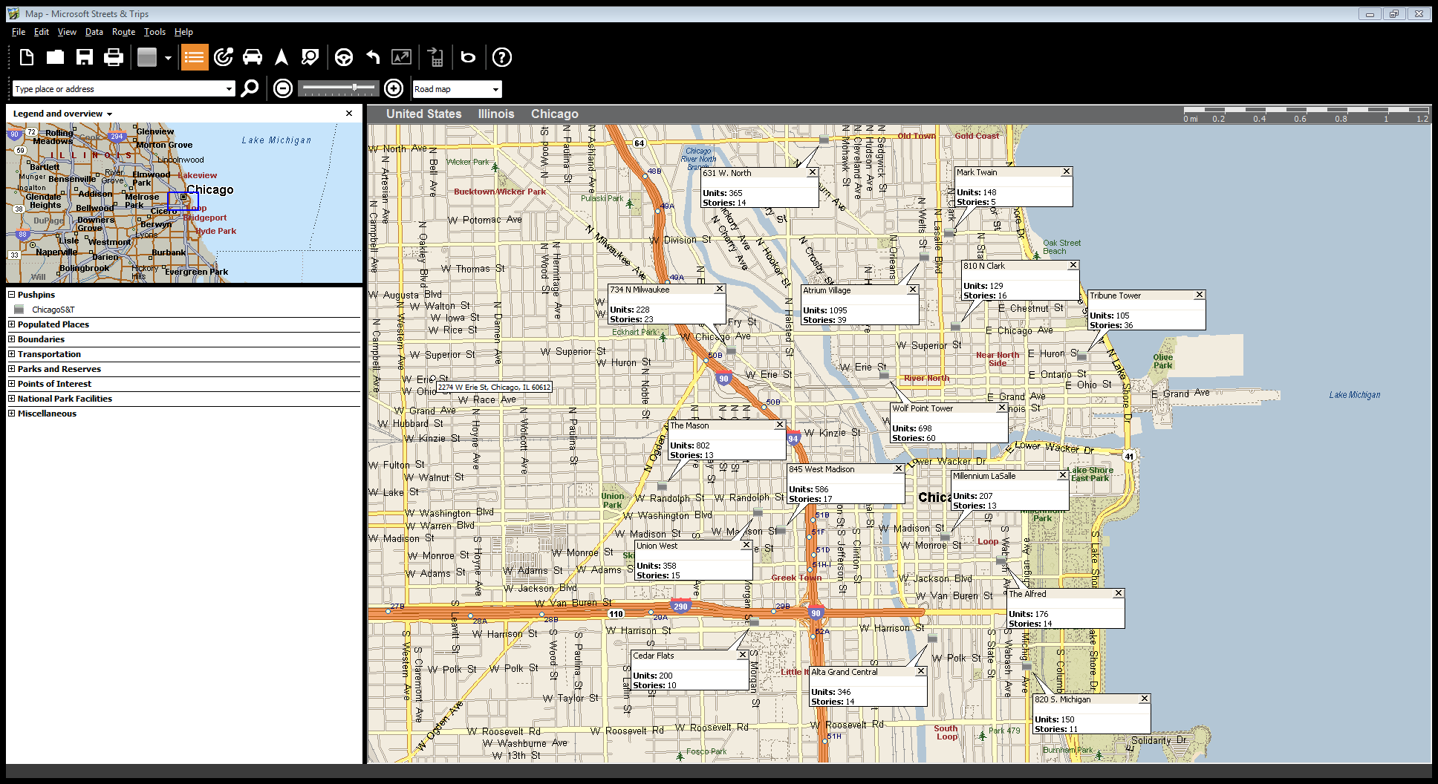
Core Urban Chicago: Loop, Near Westside, Near North, South Loop and Gold Coast U/C Supply (100+ Unit Buildings)
Total U/C Pipeline ~5,600 units or about 10% of current inventory.
Last year, absorption totaled ~ 5,000 units.
Notes:
This map identifies projects of over 50 units that currently are under construction. They incorporate about 10% of the existing 50+ stock. By way of comparison, total absorption in these submarkets reached about 5,000 units last year alone. This looks like a pretty favorable balance.

Slide 25
Chicago Core Submarket Supply Trends
Notes:
This slide illustrates past and future supply trends. The data are expressed as a trailing 12-month totals to better exhibit trends.
As you can see there will be a supply lull over the next 12 months ors so before deliveries return to their recent 3,500 to 4,000-unit run rate. We modeled supply, demand and rent behavior for this area to forecast likely occupancy and revenue trends. These are the forecasts we arrived on ….

Slide 26
METRO CHICAGO SUPPLY AND DEMAND
Notes:
Our modeling results correspond with our hunch. The most probable outcome is for Urban occupancy to rise about 100 basis points to 92.3% this year and level off at that level in 2020 and 2021.

Slide 27
Urban Core: Effective Rent Growth Forecast
Notes:
The rent outlook also is encouraging. Overall rent trends and stabilized, same-store rents recorded a nice bounce over the trailing 12 and our model expects these gains to consolidated this year. With the return of heavier supply in 2020, growth is likely to level off, but the models do not foresee much downward pressure., indeed all asset rent growth may rise somewhat with the addition of new luxury supply to the inventory. Overall, we expect the Urban Core to outperform the metro average.

Slide 28
Lease-up Trends in The Loop, Gold Coast, West Side
Decided decrease in monthly lease-up trends over the past six months of data.
Notes:
This illustrates perhaps the one potential pitfall. These are our estimates of monthly average lease-up at new properties in the infill area. Generally, averages have compared unfavorably to year-before comparisons in five of the last six months – not the direction we would like to see.

Slide 29
Chicago Cap Rate Trends
Notes:
Here are the trends of our class-B/B+ property cap rate proxy index. Chicago cap rates have compressed over the past five years, but they have lagged the national average and may be trending up a bit over the past year, as indicated by the polynomial trend line. I suspect we’ll see better movement if the market performs as we expect.

Slide 30
Chicago Summary
Chicago economy is firming and appears likely to post better performance relative to region peers and the U.S.
Growth likely to decelerate with the nation, but we do not foresee a negative annual job print in our forecast. Moody’s anticipate a small (-4,000 jobs) loss in 2021.
Occupancy likely to decline slightly overall, but Core Urban submarkets may experience moderate tightening.
Rent trends overall will mirror U.S. large market averages, but Core Urban submarkets may outperform the metro average.
Cap rates trends have trailed U.S. averages, but this may change should relative Chicago economic performance continue to improve.

Slide 31
DETROIT
DETROIT
DETROIT
DETROIT
DETROIT
DETROIT
DETROIT

Slide 32
Detroit Key Economic Indicators & Forecasts
DET payrolls increased 0.6% YoY in March.
Notes:
Here are our Detroit metro economic projections. Generally, they illustrate that recent income and job growth have performed near to the national average in recent years, but that trends are likely to exhibit relative deterioration as the economy slows. Job growth is especially vulnerably as the model projects net jobs losses in 2020 and 2021.
This is the kind performance you would expect an unbiased, historically specified model to produce. Detroit’s historic series frankly are very bad.
Logically, we expect better performance than this. Detroit and Michigan leaders have pulled out all the stops to refashion the metro economy to lessen dependence on the auto industry and in some meaningful sense they have been successful. It will be interesting to see how the metro performs under recessionary stress that must come at some point. In any event, we expect it to be better than what is depicted here.

Slide 33
METRO CHICAGO SUPPLY AND DEMAND
Notes:
Here are the permitting trends. Issue declined materially last year, suggesting that forward supply levels will be more constructive for occupancy here than in most markets we cover.

Slide 34
METRO CHICAGO SUPPLY AND DEMAND
Notes:
And, indeed, that’s what are forecast holds. We’re expecting a bit of an occupancy decline this year under some pressure, but the longer-term outlook is promising, with occupancy remaining at 97% in 2020 and 2021, regardless of the poor underlying economic forecast that we beliece exaggerates the degree to which jjobs and income will be stressed under growth recession national circumstances.

Slide 35
Detroit: Effective Rent Growth Forecast
Personal Income and job growth a statistically significant and won’t help Detroit rent trends.
Notes:
The corresponding rent forecast depicts further underperformance relative to the nation. Indeed, Detroit is expected to produce some of slowest compound annual rent growth over the 5-year forecast interval, around 1.8% per year.

Slide 36
Detroit Supply 2019 – 2020: Urban Core v. Other URBAN SUPPLY (CITY WEST, LOOP, GOLD COAST)
According to Reis, about 35% of 2019 and 2020 Detroit supply will delivered to the Downtown and Midtown submarkets. The figure is expected to decrease to 22% in 2021-2022.
Notes:
As for Urban Core supply, this year and next are likely to the cycle peak years. We expect about 950 units to be completed in the Downtown and Midtown submarkets in 2019 and 2019 or About 35% of metro supply.
Urban concentration is likely to decline to a manageable 22% in 2021 and 2022.

Slide 37
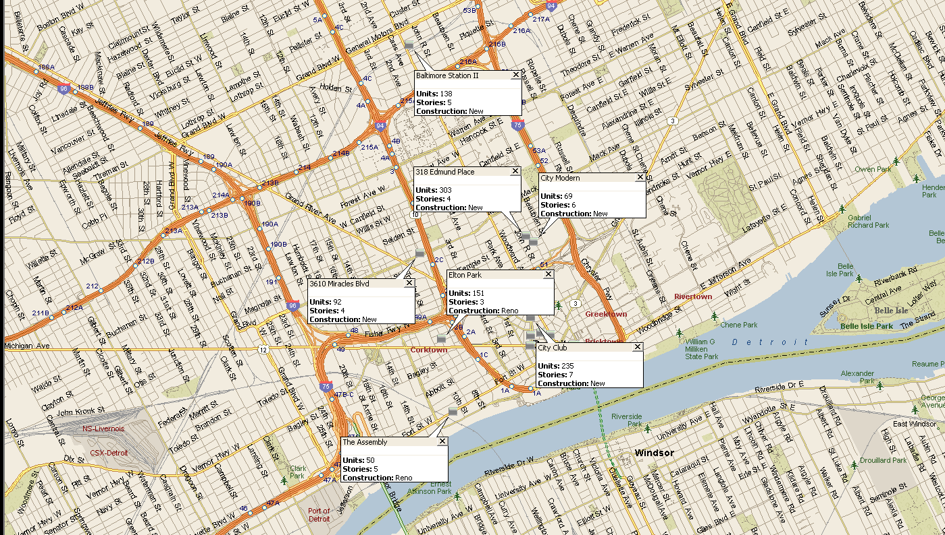
Core Urban Detroit: Downtown, Midtown, North End Beyond Times & Cadillac Squares (60+ Unit Buildings)
Total U/C Pipeline ~5,600 units or about 10% of current inventory.
Last year, absorption totaled ~ 5,000 units.
1,038 units
Notes:
Here’s what’s under construction, first outside the Cadillac and Times Square area totaling about 1,000 units,

Slide 38
Core Urban Detroit: Downtown, Midtown, North End Within Times & Cadillac Squares (60+ Unit Buildings)
Total U/C Pipeline ~5,600 units or about 10% of current inventory.
Last year, absorption totaled ~ 5,000 units.
1,346 Units
Notes:
…and next in the intense urban revelopment area, where under construction supply totals about 1,400 unbits.

Slide 39
Detroit Core Submarket Supply Trends
Notes:
The supply is a bit backed weighted in this case, tied to the delivery dates of a couple ambitious high-rises in the central CBD. This will be the acid test of the Detroit renaissance-renaissance. If the developers can lease-up these buildings under what is likely to be less propitious economic circumstances, Detroit investors and their lenders should be well-pleased, indded.

Slide 40
Urban Core: Occupancy Forecast
Coefficient for inventory growth variable is 76.8%! Demand has been consistently strong in Central Detroit. Other variables (job and home price growth) are constructive in 2021-2022.
Notes:
Here’s our forecast and it is very optimistic, indeed! As you can see, our model expects core urban

Slide 41
Urban Core: Effective Rent Growth Forecast
Payroll growth, occupancy, lagged absorption and lagged same-store rent growth are significant.
Notes:
Here’s the corresponding rent forecast. Note the significant recent improvement in stabilized, same-store rent growth. This suggests a real letter grade gain in submarket conditions that we think is sustainable.

Slide 42
Lease-up Trends in Central Detroit
Decrease in monthly lease-up trends over the past six months of data.
Notes:
Looking at the lease-up trends, we see a somewhat similar pattern to Chicago, with recent performance comparing unfavorably to year-ago levels in recent months. This is probably the biggest fly in the Detroit ointment and bears further review.

Slide 43
Detroit Cap Rate Trends
Notes:
Detroit cap rates have come down dramatically in the past five years but remain well above the US average and among the highest in te country. It appears to my eyes that return potential is attractive if economic performance does surprise to the upside.

Slide 44
Detroit Summary
Detroit economic performance has been good, but not great. Recent deceleration is a cause for concern and contributes to our soft forecast.
Growth likely to decelerate with the nation, leading RCR to project net job losses developing later this year. Moody’s are more optimistic, foreseeing net job gains in 2019 and 2020, a loss in 2021.
Tight metro occupancy likely to decline only slightly. Space in core urban submarkets in high demand.
Rent trends expected to be near the bottom of U.S. large market rankings, but core urban submarkets likely to outperform the metro average.
Cap rates have fallen dramatically but remain above U.S. averages.
Expected returns are constructive in spite of slow rent growth forecast

Slide 45
MINNEAPOLIS
MINNEAPOLIS
MINNEAPOLIS
MINNEAPOLIS
MINNEAPOLIS
MINNEAPOLIS
MINNEAPOLIS

Slide 46
Minneapolis Key Economic Indicators & Forecasts
DET payrolls increased 0.6% YoY in March.
Notes:
Well, I’ve been pretty upbeat so far and that’s going to come to an end in the place one would least expect it: Minneapolis.
Here’s the economic outlook. I want to focus on the jobs graph to your right. Note that YoY growth was negative in the first quarter, quite a surprising result for this economically vibrant area.
The source of recent weakness also is surprising – the typically bulletproof business and healthcare services sectors. Both sectors posted substantial year-on-year headcount declines.
I suspect that these data will be revised up at some point but the pattern will look pretty ugly nevertheless, especially as it strikes at the core of the MSP economic engines.
As a result, our jobs forecast for 2019-20290 is pretty weak and that couldn’t come at a less opportune time for the metro’s apartment market.

Slide 47
METRO CHICAGO SUPPLY AND DEMAND
Notes:
As illustratewd here in the permit data, supply is going to be substantial and could rise as we get into 2020 and 2021.

Slide 48
METRO CHICAGO SUPPLY AND DEMAND
Occupancy is likely to subside moderately through 2021, should the economy continue to expand at a below par rate.
Notes:
Here’s our metro forecast. As it is, we project that occupancy is likely to decline about 50 basis points this year if job growth is as weak as we anticipate, and its unlikely to recover much lost ground over the next couple of years.

Slide 49
Minneapolis: Effective Rent Growth Forecast
Occupancy, occupancy change and job growth are statistically significant rent predictors. None is likely to propel rent trends materially higher over the next several years.
Notes:
Rent growth is likely to suffer commensurately. Our 5-year forecast of 2.2% compound annual growth puts it behind Columbus, Indianapolis and even Kansas City, a place Minneapolis is uncommonly found.

Slide 50
Minneapolis Supply 2019 – 2020: Minneapolis Submarket v. Other(CITY WEST, LOOP, GOLD COAST)
According to Reis, about 40% of 2019 and 2020 Minneapolis supply will delivered to the Minneapolis submarket, up from 29% in 2017-2018. The figure is expected to decrease to 18% in 2021-2022.
Notes:
Urban supply concentration will be a contributing factor. The concentration of supply in the Minneapolis City submarket will rise from 29% in 2017-2018 to 40% this year and next. If office using job creation is going to be down, this could produce a meaningful imbalance of supply and demand.

Slide 51
Core Urban Minneapolis: Central Minneapolis, Warehouse District, Saint Anthony (60+ Unit Buildings)
Total U/C Pipeline ~5,600 units or about 10% of current inventory.
Last year, absorption totaled ~ 5,000 units.
2,525 units
Notes:
Here’s what’s underway now, first in the CBD , about 2,500 units, and then ….

Slide 52
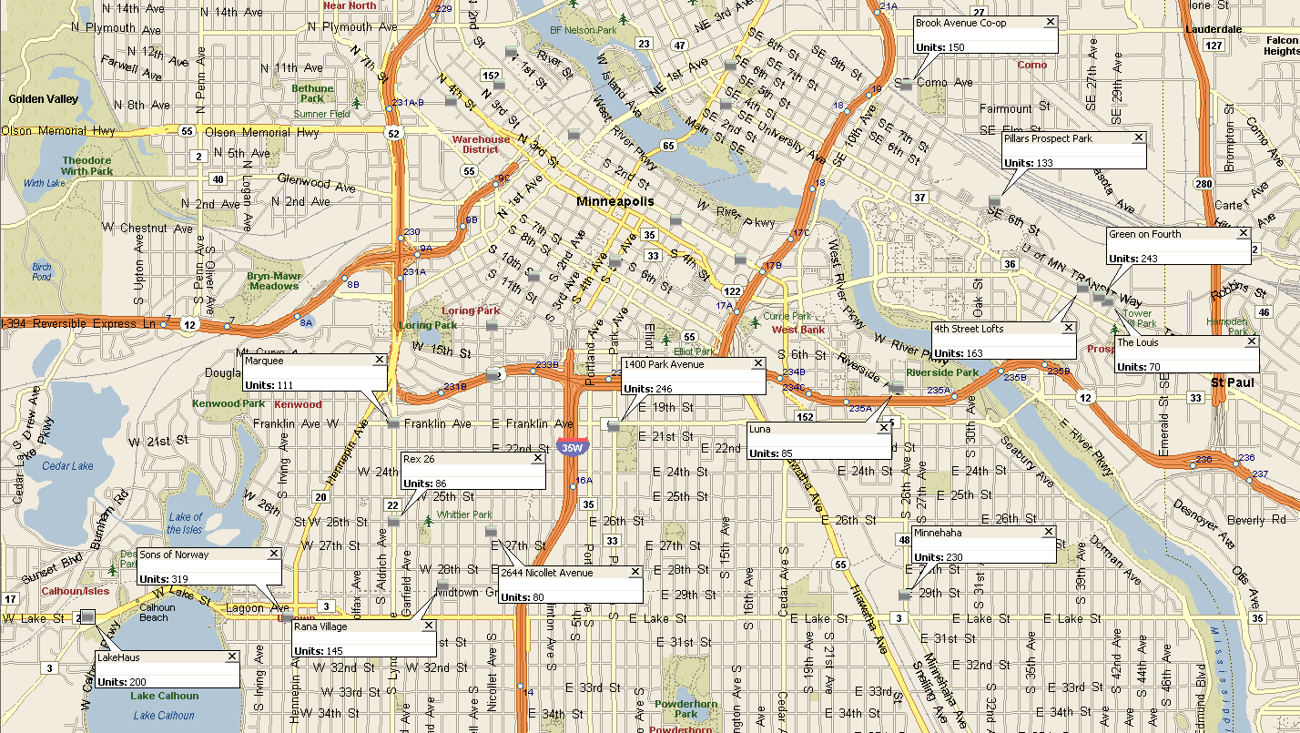
South/East Urban Minneapolis: Prospect Park/University, Uptown
Total U/C Pipeline ~5,600 units or about 10% of current inventory.
Last year, absorption totaled ~ 5,000 units.
2,325 units
Notes:
… in Uptown and Prospect Park, about 2,300 units. This represents about 20% of the existing 60+ unit stock.

Slide 53
Minneapolis Core Submarket Supply Trends
Notes:
Deliveries are tipped to subside this year, but a torrent is expected to arrive from mid-2020 to the end of 2021.

Slide 54
Urban Core: Supply and Demand Forecast

Slide 55
Urban Core: Occupancy Forecast
Notes:
Indeed, our Downtown demand model projects that we are likely to see a measurable downtick in Downtown occupancy. The most probable outcome is a decrease of about 300 basis points by 2022 to the high-80% area.

Slide 56
Urban Core: Effective Rent Growth Forecast
Equations do not use submarket occupancy as a variable. If it were used (it is statistically significant) results would be considerably worse.
Notes:
Same-store rents actually were negative in 1Q19. We expect them to improve and drift up toward the metro average as illustrated here. One technical note, the current vacancy rate is very statistically significant in this case but we excluded it because of a circular logic issue. If it were included, projected rent growth would be considerably weaker.

Slide 57
Lease-up Trends in Downtown/Uptown Minneapolis
Decrease in monthly lease-up trends over the past three months of data.
Notes:
Here’s our Downtown lease-up table. The key takeaway is circled. Early 2019 absorption is positive but down sharply from 2018 comparisons. We will want to see some improvement in this metric in coming months.

Slide 58
Minneapolis Cap Rate Trends
Notes:
Apparently, investors haven’t received my memo. Investment sales are very strong and cap rates have moved decisively lower over the past year to the lowest levels in the Midwest Region. I think some caution is warranted on valuations at this point until we see improvement in the job numbers.

Slide 59
Minneapolis Summary
After a long string of strong job growth numbers Minneapolis economic trends recently exhibited rare degree of weakness. Although a quick rebound is possible, MSP likely to lag peers.
Pent up demand for new space remains but increasing product delivery will exert downward pressure on occupancy.
Metro occupancy likely to decline slightly but remain above 95% for the foreseeable future.
Rent trends decelerated as job gains waned. Near-term growth is likely to fall below the robust levels observed earlier in the cycle.
The investor bid for MSP properties did not wane, however, and cap rates continued to compress during the recent soft patch.
Expected returns are constructive but MSP has fallen down in the large market rankings. Central Minneapolis may be entering an period of oversupply with potentially negative impact on returns.

Slide 60
Midwest Market Total Performance Rankings
Metro | 5-yr Rent CAGR | 5-yr Occupancy Change | Going-in Cap Rate | Exit Cap Rate | Expected Total Return | RED 50 Rank | Risk-adjusted Index Rank
Chicago | 2.4% | -0.1% | 5.20% | 5.20% | 7.79% | 25 | 9
Cincinnati | 2.5% | -0.7% | 6.00% | 6.00% | 8.59% | 8 | 16
Columbus | 2.8% | -1.1% | 5.80% | 5.80% | 8.83% | 6 | 3
Detroit | 1.7% | 0.0% | 6.00% | 6.00% | 7.61% | 35 | 14
Indianapolis | 2.9% | -2.2% | 5.70% | 5.70% | 8.55% | 9 | 6
Kansas City | 2.3% | -0.2% | 5.60% | 5.60% | 7.90% | 23 | 20
Milwaukee | 1.8% | 1.2% | 6.10% | 6.10% | 8.04% | 18 | 8
Minneapolis | 2.2% | -0.1% | 5.15% | 5.15% | 7.56% | 36 | 24
Saint Louis | 2.7% | -2.0% | 6.00% | 6.00% | 8.32% | 14 | 5
RED 50 | 2.5% | -0.5% | 5.12% | 5.12% | 7.75%
Five of the Top Nine Midwest Markets in the RED 50 Top 10 for Expected Total Returns.

Slide 61
Midwest Market Total Performance Rankings
Metro | 5-yr Rent CAGR | 5-yr Occupancy Change | Going-in Cap Rate | Exit Cap Rate | Expected Total Return | RED 50 Rank | Risk-adjusted Index Rank
Chicago | 2.4% | -0.1% | 5.20% | 5.20% | 7.79% | 25 | 9
Cincinnati | 2.5% | -0.7% | 6.00% | 6.00% | 8.59% | 8 | 16
Columbus | 2.8% | -1.1% | 5.80% | 5.80% | 8.83% | 6 | 3
Detroit | 1.7% | 0.0% | 6.00% | 6.00% | 7.61% | 35 | 14
Indianapolis | 2.9% | -2.2% | 5.70% | 5.70% | 8.55% | 9 | 6
Kansas City | 2.3% | -0.2% | 5.60% | 5.60% | 7.90% | 23 | 20
Milwaukee | 1.8% | 1.2% | 6.10% | 6.10% | 8.04% | 18 | 8
Minneapolis | 2.2% | -0.1% | 5.15% | 5.15% | 7.56% | 36 | 24
Saint Louis | 2.7% | -2.0% | 6.00% | 6.00% | 8.32% | 14 | 5
RED 50 | 2.5% | -0.5% | 5.12% | 5.12% | 7.75%
Five of the Top Nine Midwest Markets in the RED 50 Top 10 for Risk-adjusted Returns.

Slide 62
Columbus Downtown Lease-up Trends
Columbus Downtown space demand was unusually strong last summer. Absorption year-to-date 2019 was in line with the 2017 nd 2018 experience.

Slide 63
Urban Core: Stabilized Same-store Occupancy

Slide 64
Urban Core: Stabilized Same-store Rent Trends

Slide 65
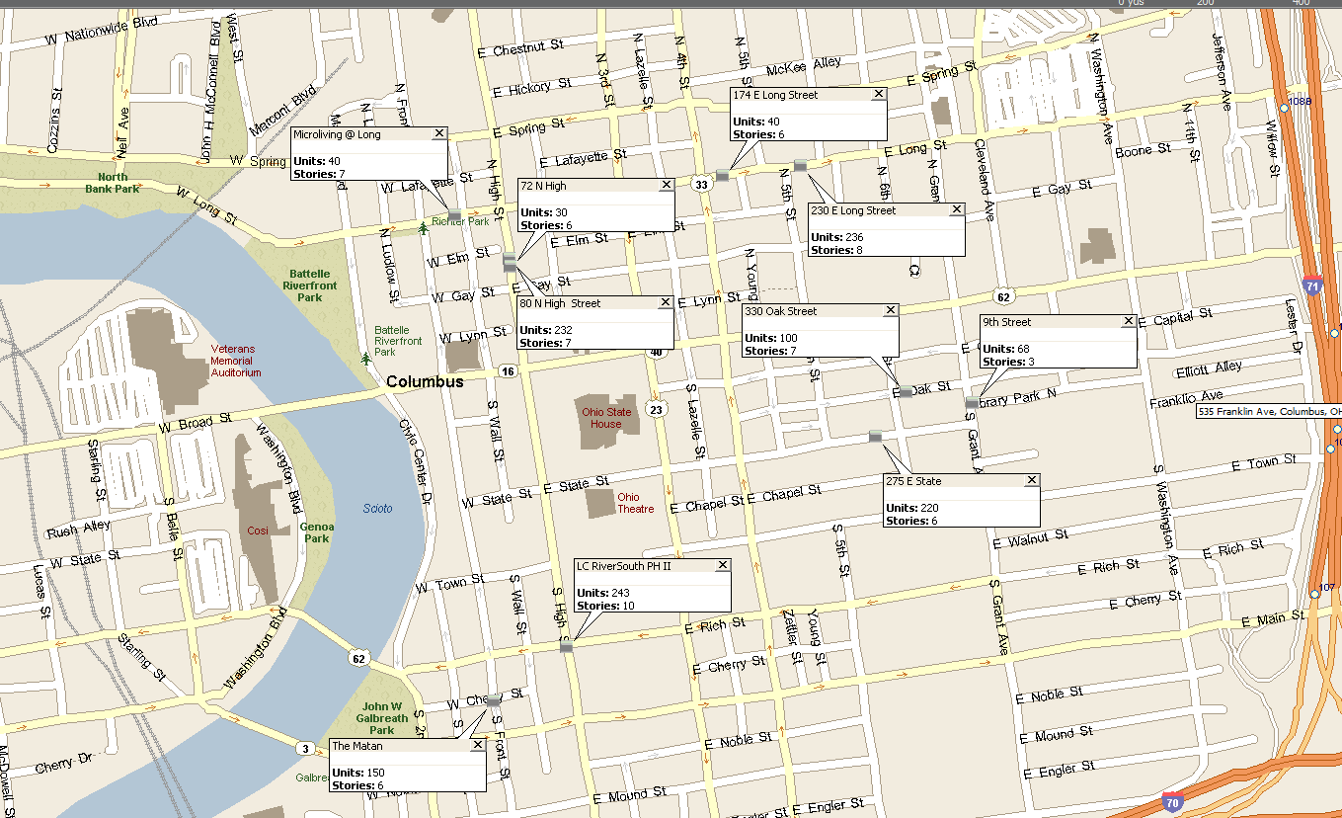
Downtown Columbus: Under Construction 50 Units+
Total U/C Pipeline ~5,600 units or about 10% of current inventory.
Last year, absorption totaled ~ 5,000 units.
1,359 units or 38% of the existing 50+ Inventory

Slide 66
Short North / OSU: Under Construction 50 Units+
Total U/C Pipeline ~5,600 units or about 10% of current inventory.
Last year, absorption totaled ~ 5,000 units.
981 units or about 28% of existing 50+ inventory.

Slide 67
Indianapolis Downtown Lease-up Trends
Like Columbus, Indianapolis Downtown space demand was strong last summer. Absorption year-to-date 2019 was in line with the 2017 and 2018 experience.

Slide 68
Urban Core: Stabilized Same-store Occupancy

Slide 69
Urban Core: Stabilized Same-store Rent Trends

Slide 70
Central Indianapolis: Under Construction 50 Units+
Total U/C Pipeline ~5,600 units or about 10% of current inventory.
Last year, absorption totaled ~ 5,000 units.
1,035 units in six projects or about 13% of existing 50+ inventory.

Slide 71
Milwaukee Downtown Lease-up Trends
Milwaukee Downtown space demand appears to have cooled off since 2017. This is partially attributable to a decline in deliveries. Only three assets were completed in 2018 and YTD 2019.

Slide 72
Urban Core: Stabilized Same-store Occupancy

Slide 73
Urban Core: Stabilized Same-store Rent Trends

