Slide 1
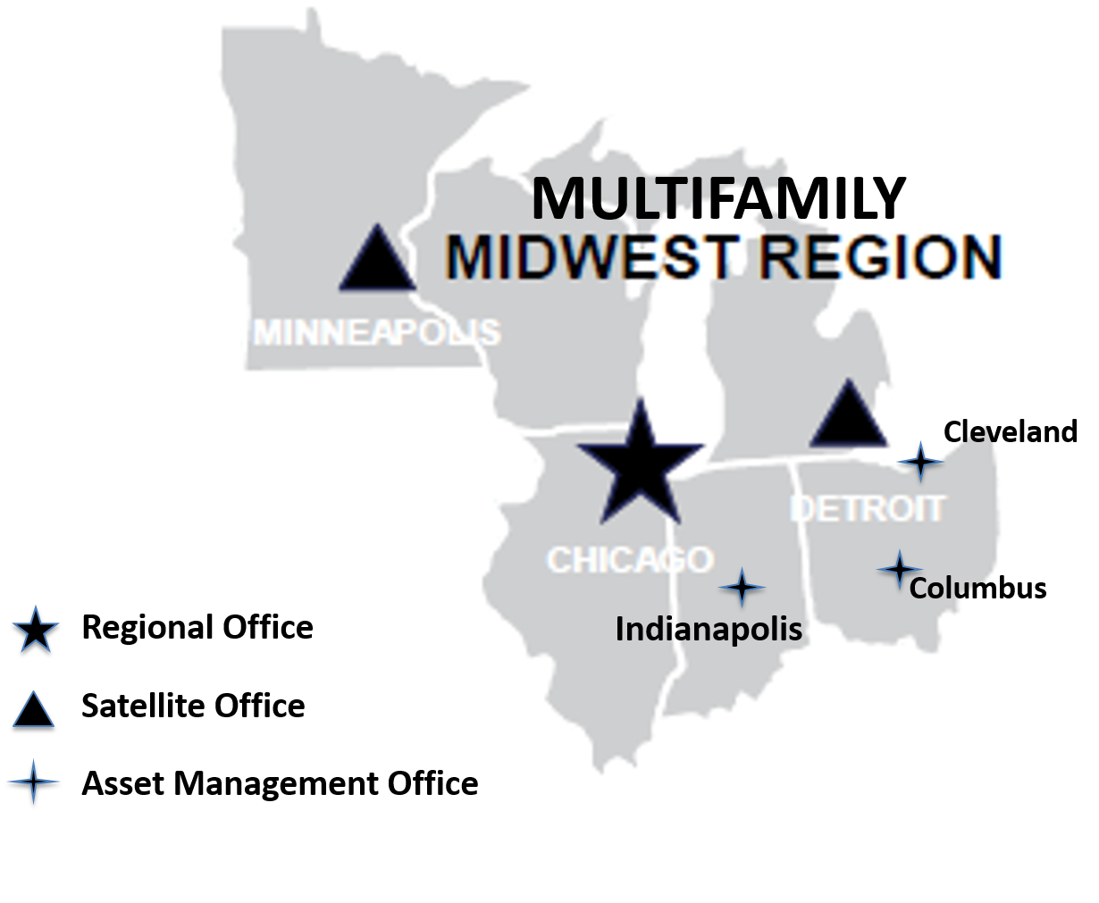
Multifamily Midwest Region
Milwaukee
Dan Burke
Director, Multifamily Midwest Region
Chicago, IL
Midwest Lenders Conference
August 28, 2019

Slide 2
Chicago Regional Center Asset Management Staffing
Debbie Gray
Asset Management Division Director (Chicago)
Gwen Thomas
Branch Chief, AE Branch 1 (Chicago)
Susie Sapilewski
Asset Management Division Director/Satellite Office Coordinator (Detroit)
Josh Osborne
Branch Chief, AE Branch 1 (Detroit)
Alicia Brown
Branch Chief, AE Branch 2 (Detroit)
Laura Simpson
Asset Management Division Director/Satellite Office Coordinator (Minneapolis)
Gail Burks
Branch Chief, AE Branch 3 (Chicago)
Lillian Fuentes
Branch Chief, AE Branch 4 (Chicago)
Gerald Smith
Branch Chief, ARS Branch 1 (Chicago)
Sylvia Davis
Branch Chief, ARS Branch 2 (Chicago)
Mary Mathis
Branch Chief, AE Branch 3 (Detroit)
Janice Shriver
Branch Chief, AE Branch 4 (Columbus)
John Schuster
Branch Chief, AE Branch 5 (Cleveland)
Andy Uzzle
Branch Chief, ARS Branch (Detroit)
Joseph Thibedeau
Branch Chief, AE Branch 1 (Milwaukee)
Elterro Carroll
Branch Chief, AE Branch 2 (Minneapolis)
Tiffany Mielke
Branch Chief, ARS Branch (Minneapolis)

Slide 3
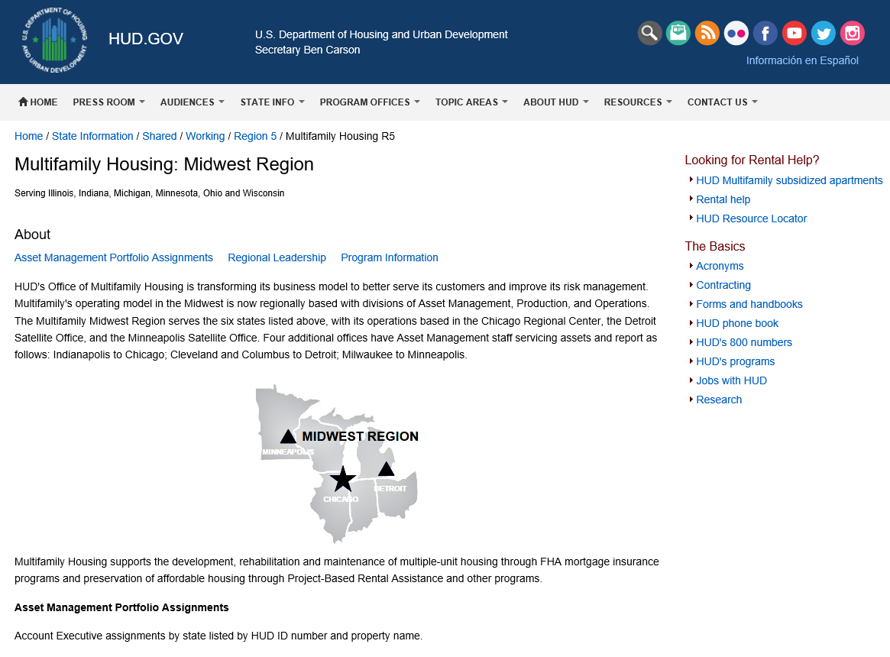
Regional Website https://www.hud.gov/states/shared/working/r5/multifamily

Slide 4
Midwest Regional Organizational Chart and Portfolio Assignments
Midwest Multifamily Asset Management Portfolio Listings
https://www.hud.gov/states/shared/working/r5/multifamily
Midwest Multifamily Staff Directory
Chicago - https://www.hud.gov/sites/documents/AM_Chicago_Staff.pdf
Detroit - https://www.hud.gov/sites/documents/AM_Detroit_Staff.pdf
Minneapolis - https://www.hud.gov/sites/documents/AM_Minneapolis_Staff.pdf

Slide 5
Agenda
Introductions
Overview of Contract Renewals
Management Exhibits
General Asset Management Servicing and Processing Timelines
Where to Find HUD Guidelines and Updates
Questions

Slide 6
Contract Renewals
Option 1 – Mark up to Market
Chapter 15 – Preservation Efforts
Option 2 – Renewals for Projects with Rents at or Below Comparable Market Rents
Option 3 - Referral to Office of Recapitalization
Option 4 – Renewal of Projects Exempted from Recapitalization
Option 5 – Renewal of Portfolio Reengineering Demonstration or Preservation Projects
Option 6 – Opt-Outs

Slide 7
Management Exhibits
HUD-9839 Management Agent Certification
Affirmative Fair Housing Marketing Plans
HUD-2530 Previous Participation
General Asset Management Servicing/Timeframes
10-year PCNAs
R4R withdrawals
TPAs, Assignment of HAP, 2530, etc.
120 Day HAP renewal timeframe/MAP applications
Best Practices
Recurring problems
8bb transactions

Slide 8
Where to find HUD Guidelines, Updates…
Most Updated Section 8 Renewal Policy Guide – also contains frequently asked questions:
https://www.hud.gov/program_offices/housing/mfh/mfhsec8
Best training on Contract Renewal Options by a HUD SME in 2017 (except for some recent changes, this is the best source for understanding all differences and requirements in the several options. HUD channel on Youtube:
https://www.youtube.com/watch?v=CEBTKQj4GZM
Utility Allowance Guidance – HUD Notice H 2015-04
https://www.hud.gov/sites/documents/15-04HSGN.PDF
Best Training on RCS process and requirements
https://www.youtube.com/playlist?list=PLDYbj6cykYZ-y6tM73qGy9AJv9ag7lv1x

Slide 9
TPA guidance: Includes required attachments, exhibits, and also includes HUD notices amending the OLD chapter.
https://www.hud.gov/states/shared/working/west/mf/tpafull
TPA application: https://www.hud.gov/sites/documents/92266.PDF (Also includes guidance on Assignment of HAP contract.)
Incentives for FHA Mortgage Insurance for Properties Located in Opportunity Zones.
https://www.hud.gov/sites/dfiles/OCHCO/documents/2019-07hsgn.pdf
Management documents - old chapters, some revisions
https://www.hud.gov/sites/documents/43815C2HSGH.PDF
https://www.hud.gov/sites/documents/43815C3HSGH.PDF
2530 Previous Participation Guide
https://www.hud.gov/program_offices/housing/mfh/prevparticipation

Slide 10
Prepayment and Refinance of Section 202 Direct Loans – HUD Notice 2013-17
https://www.hud.gov/sites/documents/13-17HSGN.PDF
Section 8(bb) Transfer of Budget Authority – HUD Notice 2015-03
https://www.hud.gov/sites/documents/15-03HSGN.PDF
FAQs - https://www.housingonline.com/wp-content/uploads/2018/06/HUD-FAQ-Section-8bb1.pdf
Deferred Repayment of Flexible Subsidy Operating Assistance – HUD Notice 2011-05
https://www.hud.gov/sites/documents/11-05HSGN.PDF

Slide 11
HUD Forms, Handbooks, Guidebooks, Notices, etc. – HUDClips
https://www.hud.gov/program_offices/administration/hudclips
HUD Datasets (Income Limits, FMRs, AAFs) - HUDUser
https://www.huduser.gov/portal/home.html
RHIIP ListServ -
https://www.hud.gov/program_offices/housing/mfh/rhiip/mfhrhiip

Slide 12
Questions?

